Slide 1


MYSURU ROYAL INSTITUTE OF TECHNOLOGY
(Approved by AICTE New Delhi, Govt. of Karnataka Affiliated to VTU BELAGAVI)
Lakshmipura road, Palahally Post, Off Mysuru-Bengaluru Highway, SR Patna, MANDYA -571606
DEPARTMENT OF COMPUTER SCIENCE & ENGINEERING
Major Project
presentation
on
“AI POWERED WEB HELPDESK FOR COLLEGE INSTITUTION”
Presented by:
BHUMIKA V [4MU22CS005]
KEERTHANA M [4MU22CS030]
Under the guidance of
Prof . SEEMA FIRDOS
Assistant Professor
Dept of CSE, MRIT, Mandya.

Slide 2

PRESENTATION OUTLINE
Problem Statement
Introduction
Motivation
Literature Survey
Objectives
Methodology
Design Specifications (Hardware / Software Requirements)
Implementation
Anticipated Output / Results and Discussions
Conclusion
References

Slide 3
1. Problem Statement
Students face delays in getting answers for common queries (fees, timetable, faculty contact, events, syllabus).
Existing communication channels (notice boards, office desks) are time-consuming and not available 24/7.
No centralized, instant, and interactive platform for student queries.
Lack of voice support makes it less accessible for differently-abled or multilingual students.

Slide 4
2. Introduction
Efficient communication is essential in educational institutions, but traditional methods like notice boards and manual inquiry counters are slow and inconvenient, causing delays and extra workload.
Many students, especially differently-abled and multilingual learners, face difficulties accessing information.
AI-based helpdesk systems provide instant, accurate responses through text or voice, centralizing information, improving accessibility, and reducing administrative effort while supporting smart campus development.

Slide 5
3. Motivation
Students face delays and frustration due to slow manual inquiry systems like notice boards and office visits, while staff handle repetitive queries that increase workload.
Traditional methods are not accessible to differently-abled or multilingual students.
With AI advancements, an automated helpdesk can offer instant, accurate 24/7 support, centralize information, reduce staff burden, and modernize campuses through smart digital communication.

Slide 6
4. Literature Survey
Title of Paper | Authors | Year | Features | Limitations
College Enquiry Chatbot | Jana Preethi S. et al. | 2023 | • Questions about courses. • Reduces the need for in-person or phone enquiries | • Mainly handles fixed or FAQ-type questions • Unclear queries
Helpdesk Chatbot for Incident Classification and Resolution | D. Tipe-Palomino & W. Auccahuasi | 2024 | • Uses NLP and deep learning to classify incidents • Suggests or automates technical solutions as first-level support. | •May misclassify rare or new problems • Still needs human staff for complex cases
AI-based College Enquiry Chatbot | Gaurav Sambhe, Shanal Awaze, Shraddha Bobade, Sukesha Bhagwatkar, Prachi Bhoyar | 2023 | • Gives instant information on admissions, events, notices and activities • Lets students ask questions in natural language | • Limited to specific questions and Don’t respond to similar queries.

Slide 7
5. Objectives
Develop an AI-based helpdesk that provides instant responses to student queries.
Centralize academic and administrative information on a single platform.
Ensure 24/7 access with automated chatbot support.
Enable text and voice interaction with multilingual capability.
Reduce repetitive work for administrative staff and improve efficiency.
Provide an easy-to-use interface for web and mobile users.
Integrate with college information accessibility to all .
Support future expansion like website and mobile apps.

Slide 8
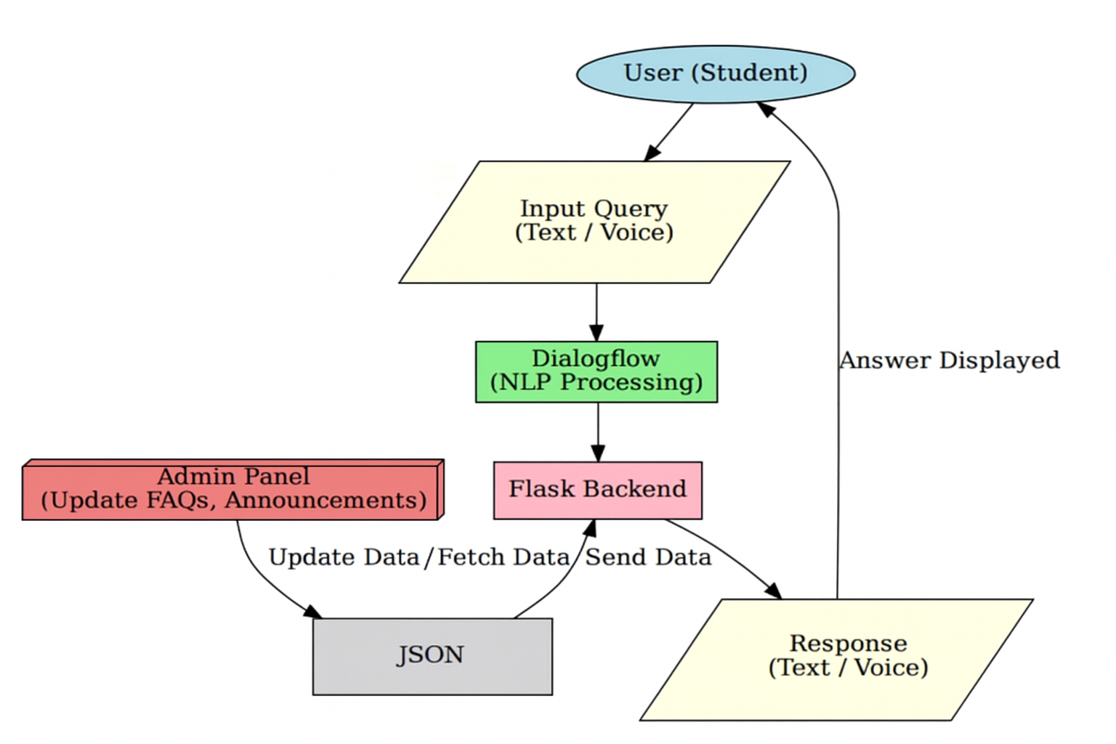
6. Methodology

Slide 9
How the methodology works :
User Interface: Web-based chat interface for seamless interaction.
NLP Engine (Dialog flow): Converts text/voice and identifies intent.
Backend (Flask): Handles logic, communication, and data flow.
Data stored : Json which Stores institutional information and logs.
Admin Panel: Manages data updates, FAQs, and announcements.

Slide 10
7. Design Specifications
(Hardware and Software Requirements)
Hardware Requirements :
Minimum Requirements (Client-Side):
Processor: Dual-core 2.0 GHz RAM: 4 GB
Storage: 256 GB HDD / 128 GB SSD
Network: 4G Internet / Wi-Fi connectivity
Recommended Requirements (Server-Side):
Processor: Quad-core 3.0 GHz or higher
RAM: 16 GB or more (for AI model processing)
Storage: 1 TB SSD (fast data retrieval and logging)
GPU (Optional): NVIDIA GPU (for deep learning models)
Network: High-speed broadband with minimum 100 Mbps bandwidth

Slide 11
Software Requirements :
Operating System: Windows / Linux (server deployment), Android/iOS (mobile app).
Programming Languages: Python (NLP, backend), Json, html, CSS, JavaScript (frontend).
Frameworks: Flask (backend).
Data stores: Json
APIs and Tools: Speech-to-Text , Text-to-Speech.
Version Control: GitHub/GitLab for collaborative development.

Slide 12
8. Implementation
Frontend: HTML, CSS, JS chat UI with voice support
Backend: Python Flask controller
NLP: Dialog flow for intent recognition
Data stores: Json knowledge base
Admin panel for updating system data
Voice-enabled, multilingual ready, real-time response system

Slide 13
Algorithm :
1. Natural Language Processing (NLP):(TOOL)
To understand and interpret user queries in natural language.
1) Sentence Segmentation.
2) Preprocessing.
3) Word Tokenization.
4) Response generate.
2. Machine Learning algorithms :
1) Sequence to Sequence (seq2seq) models.
2) Recurrent Neural Networks (RNN).
3. Pattern Matching and Rule-based algorithms:
For recognizing intent and mapping queries to appropriate responses.

Slide 14
4. Artificial Neural Networks (ANNs) :
For more human-like conversation capabilities and improving over time with interaction data.
1) Data prepare : collecting of user queries.
2) Network design : 3 layers (input, hidden and output layers).
3) Prediction : If the queries are related or not.
5. QR Code Scanner Algorithms:
1) Detection Algorithms: Often use CNNs or Faster R-CNN frameworks to detect QR code
regions images captured by mobile cameras.
2) Decoding Algorithms: ZXing ("Zebra Crossing") library and enhanced decoding methods
for extracting the embedded data (extracting of the data).

Slide 15
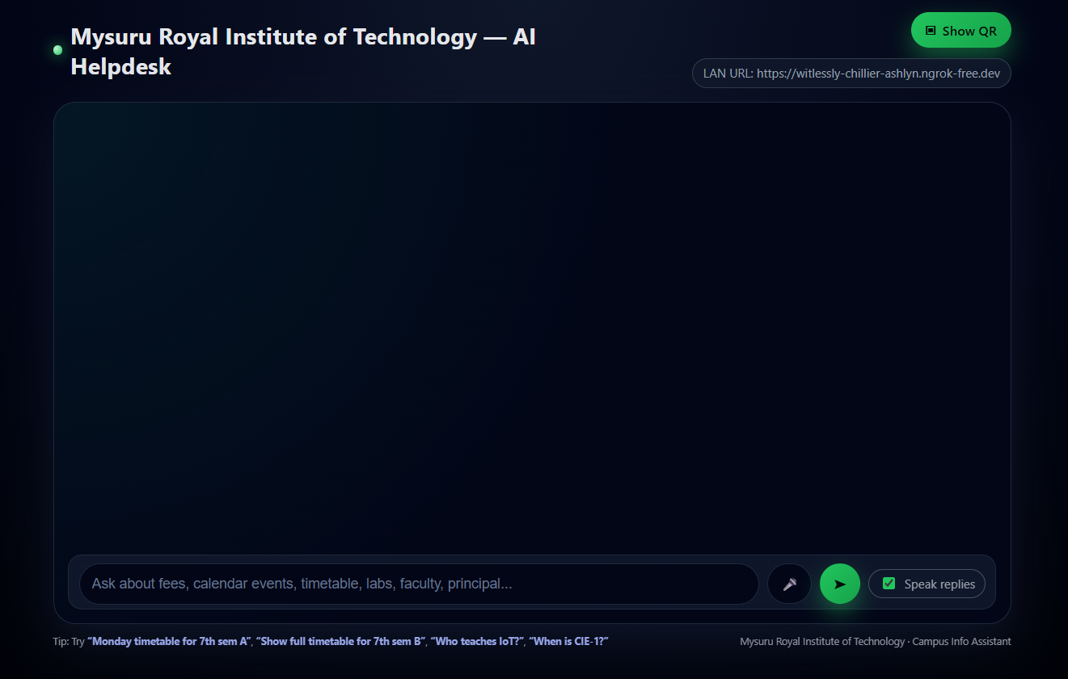
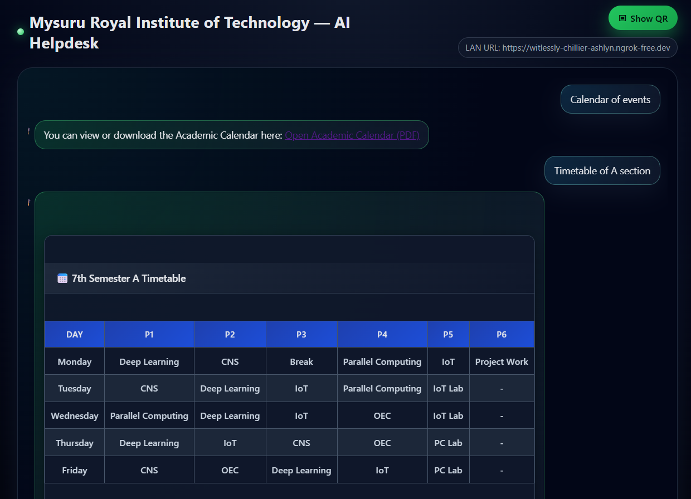
9. Results and Discussions
WEB BASED:

Slide 16
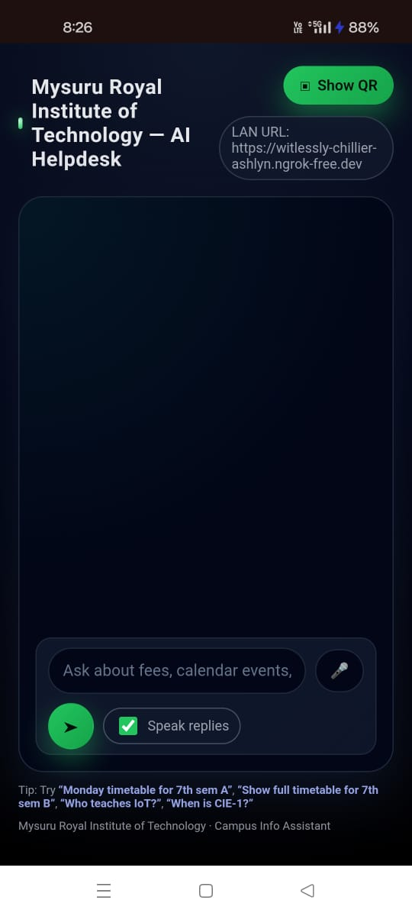
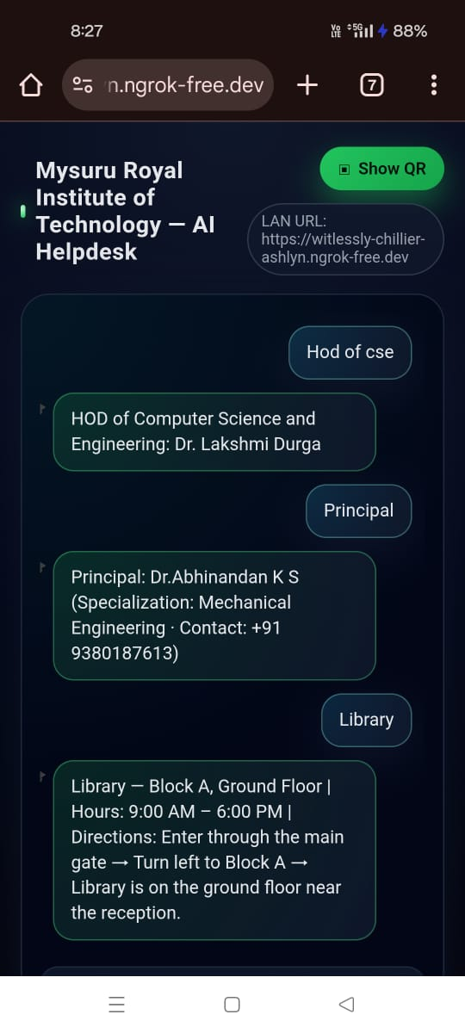
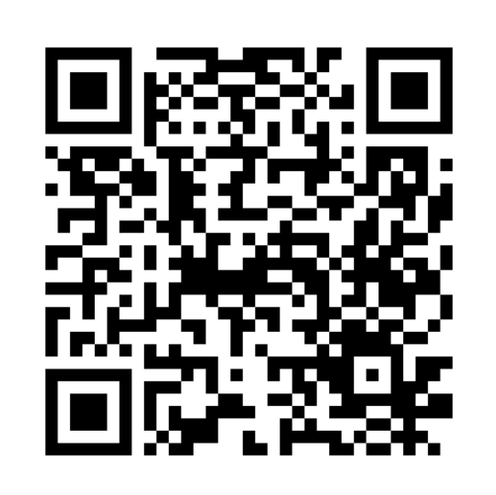
MOBILE BASED ACCESS:

Slide 17
10. Conclusion
The AI‑Powered Web Helpdesk streamlines campus communication by providing instant, reliable information through an AI chatbot.
It reduces administrative workload, minimizes delays, and ensures 24/7 accessibility for students, parents, and visitors.
With an easy‑to‑use dashboard for updates, the system enhances user experience, improves accessibility, and supports the digital transformation of educational institutions.

Slide 18
11. References
Janapreethi S., Janapriya S., Sarulatha M., & Hemalaskhmi G.R. – College Enquiry Chatbot, ViTECoN 2023, IEEE.
Tipe‑Palomino D., & Auccahuasi W. – Helpdesk Chatbot using NLP & Deep Learning, ICACRS 2024, IEEE.
ChatGPT.
Perplexity AI.

